Slide 1
Blazor Introduction
Chris Woodruff

Slide 2

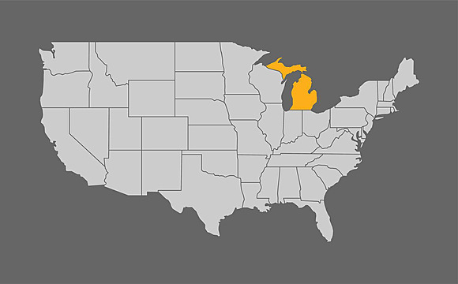
Chris Woody Woodruff
Yes, I am old
I am from Michigan in USA
I am a Solution Architect
Find me at
http://woodruff.dev

Slide 3




What is Blazor?
Blazor Brings C# to the Browser
Minimal JavaScript Required
A Framework Built for SPAs (Single-Page Applications)
Blazor Is Open Source and Cross-Platform

Slide 4




Why Choose Blazor?
Full-Stack Development with .NET
Modern, Component-Based Architecture
Seamless Integration with .NET Ecosystem
Productivity and Familiarity for .NET Developers

Slide 5


Blazor Hosting Models
Server
WebAssembly

Slide 6
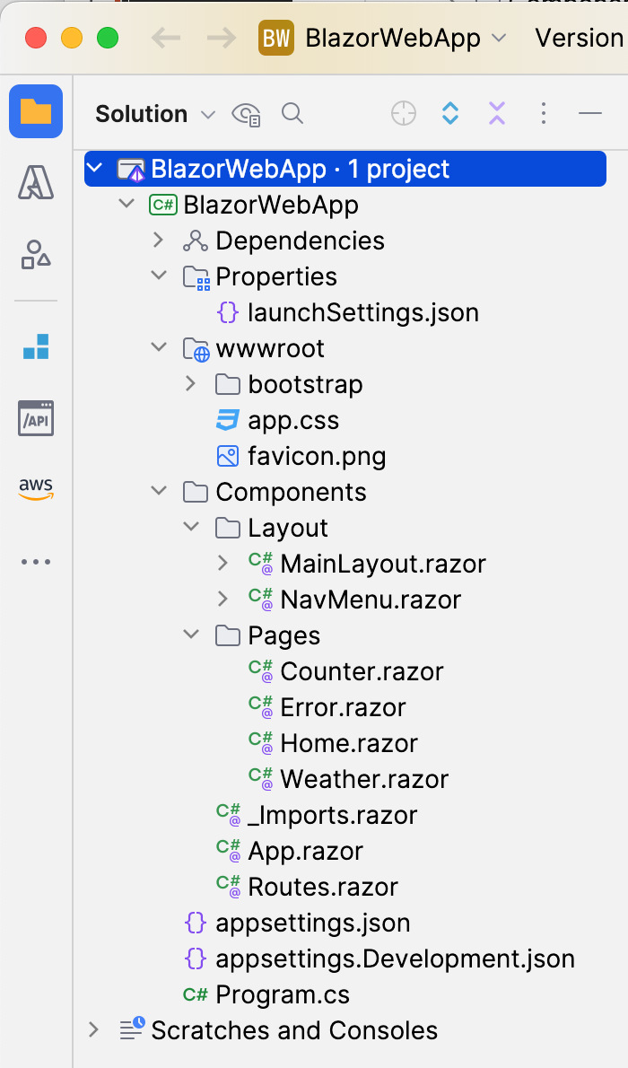
Blazor Server App
Fast Load Times
Small Client-Side Footprint
Real-Time UI Updates with SignalR
Centralized Application Logic and State Management

Slide 7
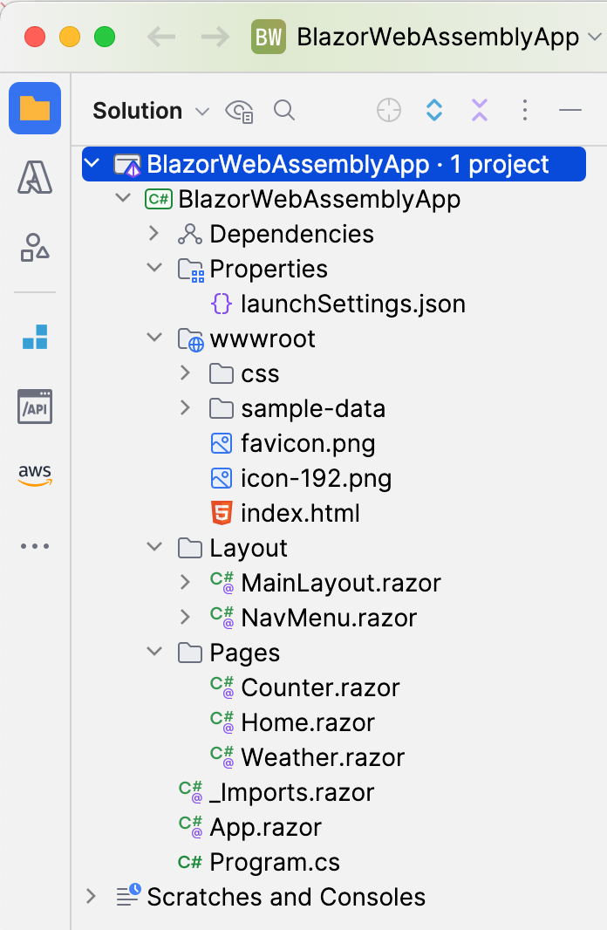
Blazor WebAssembly
True Client-Side Execution with Offline Support
Cross-Platform and No Server Dependency
Single-Page Application (SPA) with .NET Instead of JavaScript
Seamless Integration with Existing JavaScript Libraries

Slide 8
Disadvantages of Blazor
Larger Download Size
Initial Load Time
Dependency on WebAssembly
Limited Debugging Capability
Server Connection Dependency

Slide 9
Setting Up a Blazor Project
Server Web App
dotnet new blazor -o BlazorApp
WebAssembly Web App
dotnet new blazorwasm -o BlazorApp

Slide 10

Demo
1001010100101010
1010010010110111

Slide 11
Data Binding in Blazor
<input @bind="name" placeholder="Enter your name" />
<p>Hello, @name!</p>
@code {
private string name = "Blazor";
}
Notes:
The @bind directive binds the input field's value to the name variable, allowing real-time updates both ways.
As the user types in the input field, the name variable updates automatically, and any changes to name in the code are reflected in the input. The p tag then displays the updated value of name.

Slide 12
Event Handling in Blazor
<button @onclick="ShowMessage">Click me</button>
<p>@message</p>
@code {
private string message = "";
private void ShowMessage()
{
message = "Button clicked!";
}
}
Notes:
The @onclick directive binds the ShowMessage method to the button's click event.
When the button is clicked, the ShowMessage method updates the message variable, which is then displayed in the <p> tag.

Slide 13
Dependency Injection in Blazor
public class GreetingService
{
public string GetGreeting() => "Hello from Greeting Service!";
}
builder.Services.AddSingleton<GreetingService>();
@inject GreetingService GreetingService
<p>@GreetingService.GetGreeting()</p>
@code {
// No additional code needed here; the service is ready to use
}
Notes:
The service GreetingService is registered as a singleton in Program.cs.
The @inject directive injects GreetingService into the component, making it accessible as GreetingService.
GetGreeting() is called to display a message from the service in the component.

Slide 14
Lifecycle Methods
<p>Message: @message</p>
@code {
private string message;
protected override void OnInitialized()
{
message = "Component initialized!";
}
}
Notes:
The OnInitialized method is a Blazor lifecycle method that runs when the component is first initialized.
In this example, OnInitialized sets the message variable, which is then displayed in the <p> tag.
This approach is commonly used for initial setup or data fetching when the component is loaded.

Slide 15
Lifecycle Methods
<p>Message: @message</p>
@code {
private string message;
protected override void OnParametersSet()
{
message = "Parameters have been set!";
}}
Notes:
OnParametersSet / OnParametersSetAsync: For responding to parameter changes.

Slide 16
Lifecycle Methods
<p>Message: @message</p>
@code {
private string message;
protected override void OnAfterRender(bool firstRender)
{
if (firstRender)
{
message = "First render complete!";
StateHasChanged(); // Trigger a re-render
}
}}
Notes:
OnAfterRender / OnAfterRenderAsync: For actions that need the component to be rendered.

Slide 17
Lifecycle Methods
<p>Counter: @counter</p>
<button @onclick="IncrementCounter">Increment</button>
@code {
private int counter = 0;
private void IncrementCounter()
{
counter++;
}
protected override bool ShouldRender()
{
// Only re-render when the counter is an even number
return counter % 2 == 0;
}
}
Notes:
ShouldRender: For optimizing performance by controlling re-renders.

Slide 18
Lifecycle Methods
<p>Message: @message</p>
@code {
private string message;
public void Dispose()
{
// Cleanup code here
}
}
Notes:
Dispose: For cleaning up resources when the component is removed.

Slide 19
Call JavaScript from a Blazor Component
// wwwroot/js/myLibrary.js
function showAlert(message) {
alert(message);
}
<!-- Add this in the <head> section -->
<script src="js/myLibrary.js"></script>

Slide 20
// MyInterop.cs
using Microsoft.JSInterop;
using System.Threading.Tasks;
public class MyInterop
{
private readonly IJSRuntime _jsRuntime;
public MyInterop(IJSRuntime jsRuntime)
{
_jsRuntime = jsRuntime;
}
public async Task ShowAlertAsync(string message)
{
await _jsRuntime.InvokeVoidAsync("showAlert", message);
}
}

Slide 21
<!-- MyComponent.razor -->
@page "/my-component"
@inject IJSRuntime JSRuntime
<button @onclick="ShowAlert">Show Alert</button>
@code {
private MyInterop _myInterop;
protected override void OnInitialized()
{
_myInterop = new MyInterop(JSRuntime);
}
private async Task ShowAlert()
{
await _myInterop.ShowAlertAsync("Hello from JavaScript!");
}
}

Slide 22
Open Source and Free Components
Radzen
MudBlazor
Blazorise
Blazored
MatBlazor
Microsoft Fluent UI Blazor

Slide 23
Demo
1001010100101010
1010010010110111

Slide 24
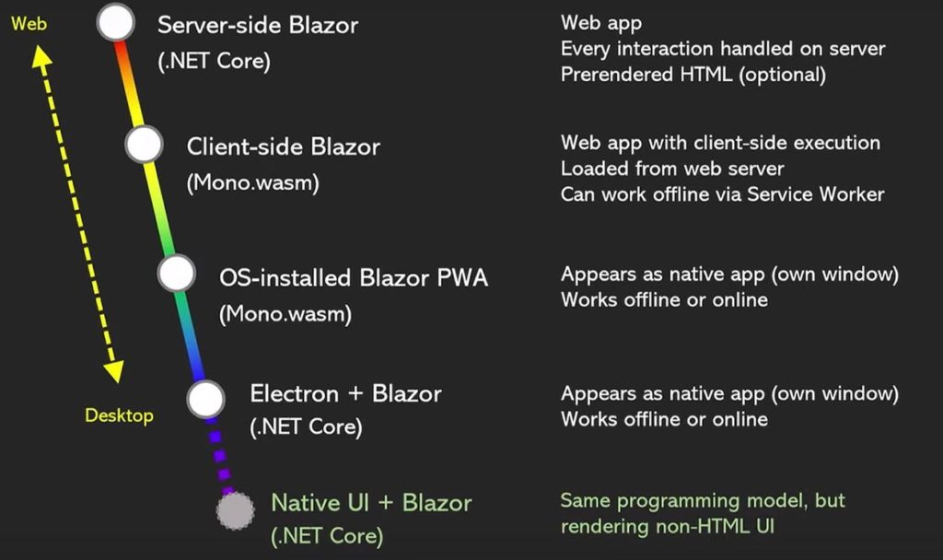
Future of Blazor and Roadmap

Slide 25
Learn More
Blazor Samples
https://github.com/dotnet/blazor-samples
Online Docs for Blazor
https://learn.microsoft.com/en-us/aspnet/core/blazor
Free Online Training
https://learn.microsoft.com/en-us/training/paths/build-web-apps-with-blazor/

Slide 26

Thanks!!
Do you have any questions?
cwoodruff@live.com
https://woodruff.dev
@cwoodruff
https://github.com/cwoodruff/blazor-introduction

